Slide 1
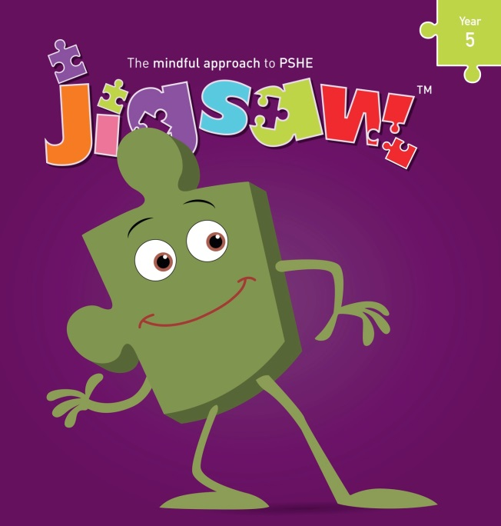

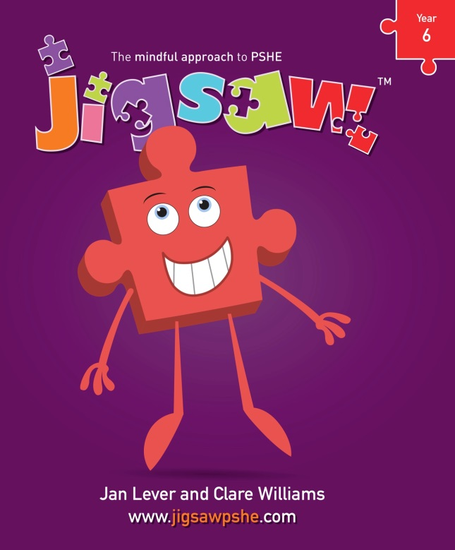
Henbury View First School
Relationships & Sex Education (RSE) 2023

Slide 2
Personal, Social, Health and Economic education
PSHE is defined as:
…a planned programme of learning through which children and young people acquire the knowledge, understanding and skills they need to manage their lives, now and in the future.

Slide 3
Starting point:
Most parents want the best for their children.
Most parents want to protect their children and to keep them safe.
Most parents want their children to be healthy and happy.
Schools do too……………………… Relationships & Sex Education (RSE) is part of this.
Parents & Carers
School
Child

Slide 4
What is Relationships & Sex Education?
It is lifelong learning about physical, moral and emotional development. It is about the understanding of the importance of family life, stable and loving relationships, respect, love and care. It is also about the teaching of sex, sexuality, and sexual health. It is not about the promotion of sexual activity – this would be inappropriate teaching.
The 4 main aims for RSE in Primary Schools:
To enable young people to understand and respect their bodies, and be able to cope with the changes puberty brings (without fear)
To understand where babies come from
To help young people develop positive and healthy relationships appropriate to their age, development etc (respect for self and others)
To support young people to have positive self and body-image, and to understand the influences and pressures around them (to be themselves)

Slide 5
Relationships Education
The focus at Henbury View is on teaching the fundamental building blocks and characteristics of positive relationships with particular reference to friendships, family relationships and relationships with other children and adults.
This will create opportunities to ensure children are taught about positive emotional and mental wellbeing and how friendships can impact on this.
Children will also be taught to recognise and report different types of abuse, including emotional, physical and sexual. This will include focusing on boundaries and privacy so that children understand that they have rights over their own bodies and know how to seek advice when they suspect or know something is wrong.
Sex Education
At Henbury View we tailor our teaching to take in account the age, physical maturity and SEND requirements of all our pupils.
From 2020, Relationships Education is compulsory in all primary schools in England. However, parents have the right to request their child be withdrawn from some or all of the Sex Education that is being delivered. If you decide to withdraw your child from the Sex Education lessons then this must be in writing via email to your child’s class teacher office@henburyview.dorset.sch.uk .
At Henbury View, we strongly recommend that all pupils are involved with Sex Education lessons.

Slide 6
Where do children now learn about
Relationships & Sex Education?
Parents/Carers
Friends
School Lessons
Playground
Magazines
Television
Internet
Mobile Phones
What would be your preferred options?
Notes:
Share the slide and pose the questions

Slide 7
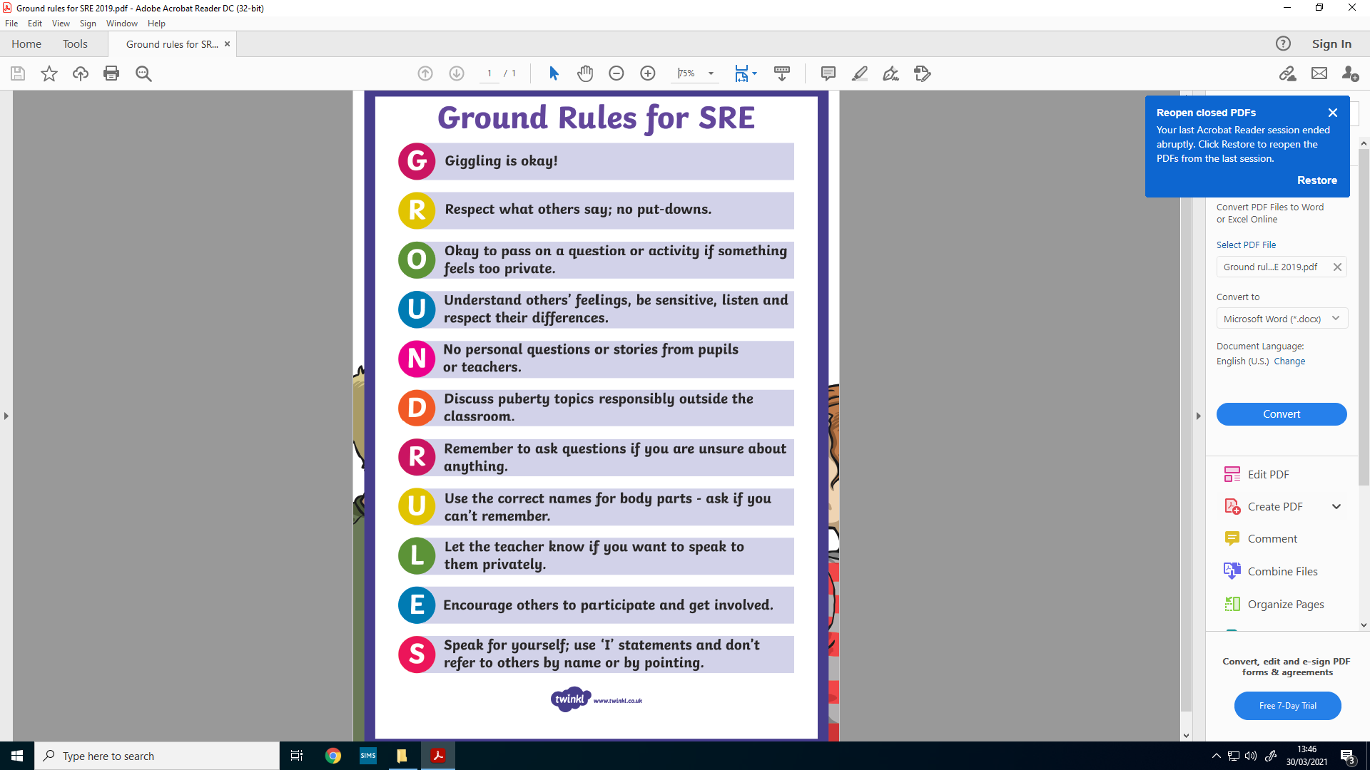
Ground Rules for RSE

Slide 8
Summary
Foundation – growing up – how we have changed since we were babies
Year 1 – Boys’ and Girls’ bodies; body parts
Year 2 – Boys’ and Girls’ bodies; body parts and respecting privacy
Year 3 – How babies grow and how boys’ and girls’ bodies change as we grow older
Year 4 – Reproductive body parts, body changes in girls and menstruation

Slide 9
The full Jigsaw Picture – Year 3
Piece Number and Name | Learning Intentions ‘Pupils will be able to…’
Piece 1 How babies grow | Understand that in animals and humans lots of changes happen between conception and growing up, and that it is usually the female who has the baby Express how I feel when I see babies or baby animals
Piece 2 Babies | Understand how babies grow and develop in the mother’s uterus Understand what a baby needs to live and grow Express how I might feel if I had a new baby in the family
Piece 3 Outside body changes | Understand that boys’ and girls’ bodies need to change so that when they grow up their bodies can make babies Identify how boys’ and girls’ bodies change on the outside during this growing up stage Recognise how I feel about these changes happening to me and know how to cope with those feelings

Slide 10
The full Jigsaw Picture – Year 3
Piece Number and Name | Learning Intentions ‘Pupils will be able to…’
Piece 4 Inside body changes | Identify how boys’ and girls’ bodies change on the inside during the growing up process and can tell you why these changes are necessary so that their bodies can make babies when they grow up Recognise how I feel about these changes happening to me and know how to cope with these feelings
Piece 5 Family stereotypes | Start to recognise stereotypical ideas I might have about parenting and family roles I can express how I feel when my ideas are challenged and might be willing to change my ideas sometimes
Piece 6 Looking ahead | Identify what I am looking forward to when I am in Year 4 Start to think about changes I will make when I am in Year 4 and know how to go about this

Slide 11
If you have further questions please do not hesitate to get in contact.

