Slide 1


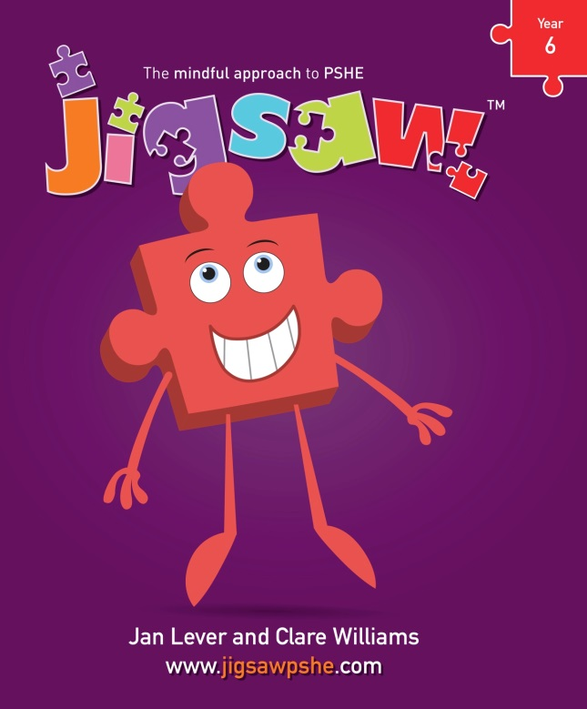
Henbury View First School
Relationships & Sex Education (RSE) 2023

Slide 2
Personal, Social, Health and Economic education
PSHE is defined as:
…a planned programme of learning through which children and young people acquire the knowledge, understanding and skills they need to manage their lives, now and in the future.

Slide 3
Starting point:
Most parents want the best for their children.
Most parents want to protect their children and to keep them safe.
Most parents want their children to be healthy and happy.
Schools do too……………………… Relationships & Sex Education (RSE) is part of this.
Parents & Carers
School
Child

Slide 4
What is Relationships & Sex Education?
It is lifelong learning about physical, moral and emotional development. It is about the understanding of the importance of family life, stable and loving relationships, respect, love and care. It is also about the teaching of sex, sexuality, and sexual health. It is not about the promotion of sexual activity – this would be inappropriate teaching.
The 4 main aims for RSE in Primary Schools:
To enable young people to understand and respect their bodies, and be able to cope with the changes puberty brings (without fear)
To understand where babies come from
To help young people develop positive and healthy relationships appropriate to their age, development etc (respect for self and others)
To support young people to have positive self and body-image, and to understand the influences and pressures around them (to be themselves)

Slide 5
Relationships Education
The focus at Henbury View is on teaching the fundamental building blocks and characteristics of positive relationships with particular reference to friendships, family relationships and relationships with other children and adults.
This will create opportunities to ensure children are taught about positive emotional and mental wellbeing and how friendships can impact on this.
Children will also be taught to recognise and report different types of abuse, including emotional, physical and sexual. This will include focusing on boundaries and privacy so that children understand that they have rights over their own bodies and know how to seek advice when they suspect or know something is wrong.
Sex Education
At Henbury View we tailor our teaching to take in account the age, physical maturity and SEND requirements of all our pupils.
From 2020, Relationships Education is compulsory in all primary schools in England. However, parents have the right to request their child be withdrawn from some or all of the Sex Education that is being delivered. If you decide to withdraw your child from the Sex Education lessons then this must be in writing via email to your child’s class teacher office@henburyview.dorset.sch.uk .
At Henbury View, we strongly recommend that all pupils are involved with Sex Education lessons.

Slide 6
Where do children now learn about
Relationships & Sex Education?
Parents/Carers
Friends
School Lessons
Playground
Magazines
Television
Internet
Mobile Phones
What would be your preferred options?
Notes:
Share the slide and pose the questions

Slide 7
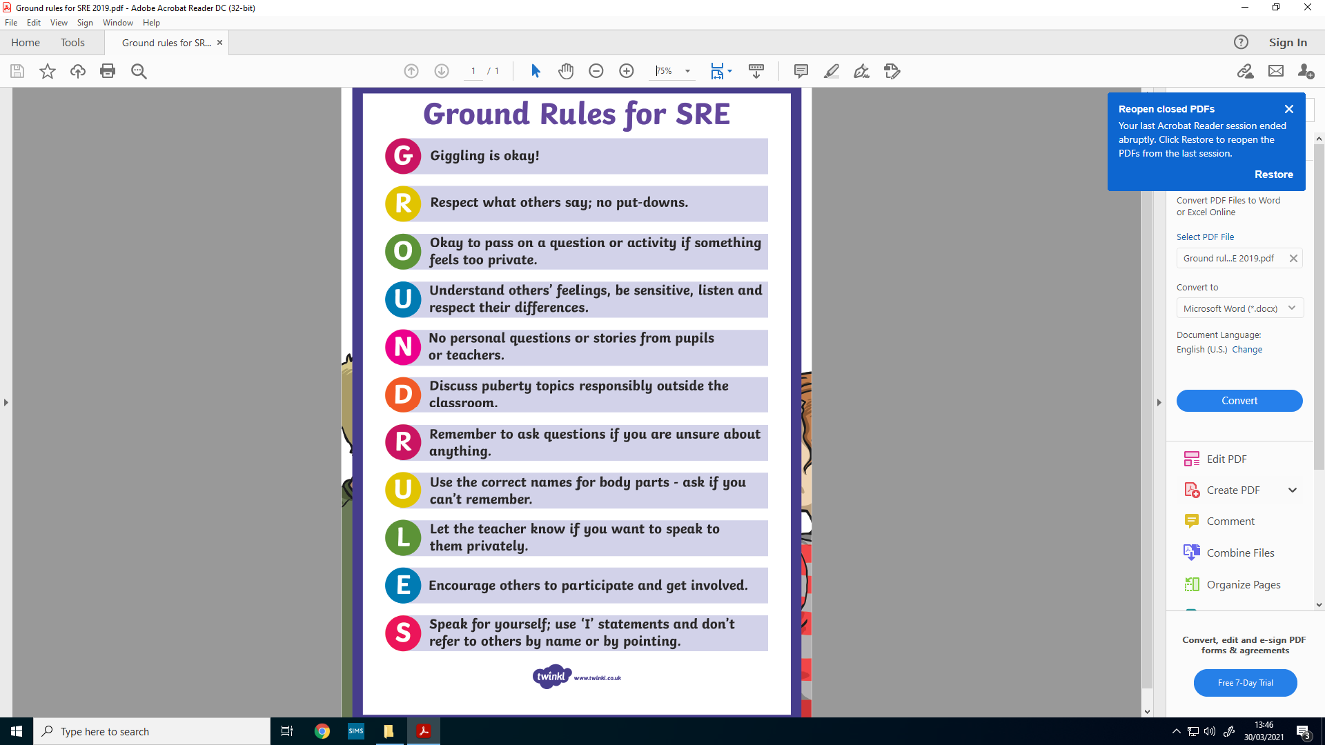
Ground Rules for RSE

Slide 8
Summary
Foundation – growing up – how we have changed since we were babies
Year 1 – Boys’ and Girls’ bodies; body parts
Year 2 – Boys’ and Girls’ bodies; body parts and respecting privacy
Year 3 – How babies grow and how boys’ and girls’ bodies change as we grow older
Year 4 – Reproductive body parts, body changes in girls and menstruation

Slide 9
The full Jigsaw Picture – Year 4
Piece Number and Name | Learning Intentions ‘Pupils will be able to…’
Piece 1 Unique Me | Understand that everyone is unique and special. Understand that some personal characteristics have come from birth parents and that this happens because we are made from the joining of our parents’ egg and sperm.
Piece 2 Having a Baby | Express how we feel when change happens. Correctly label the internal and external parts of male and female bodies that are necessary for making a baby.
Piece 3 Girls and Puberty | Understand and respect the changes we see in ourselves. Describe how a girl’s body changes in order for her to be able to have babies when she is an adult, and that menstruation (having periods) is a natural part of this.

Slide 10
The Full Jigsaw Picture – Year 4
Piece Number and Name | Learning Intentions ‘Pupils will be able to…’
Piece 4 Circles of Change | Understand and respect the changes that we see in other people. Know how the circle of change works and apply it to changes I want to make in my life.
Piece 5 Accepting Change | Know who to ask for help if we are worried about change. Identify changes that have been and may continue to be outside of our control and learn how we can accept them.

Slide 11
If you have further questions please do not hesitate to get in contact.

